Slide 1
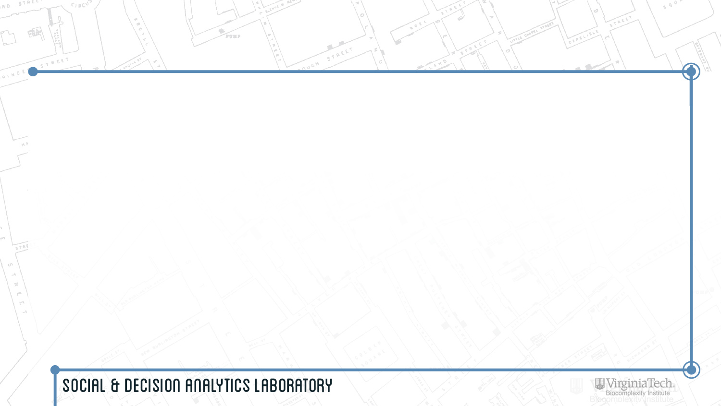
Identifying All (Traditional and Non-traditional)
STEM Pathways
NSF National Center for Science and Engineering Statistics (NCSES) is responsible for the collection, interpretation, analysis, and dissemination of objective data on the science and engineering enterprise. They are responsible for statistical data on:
  Research and Development, and Innovation
  The science and engineering workforce
  U.S. competitiveness in science, engineering, technology, and R&D
  The condition and progress of STEM education in the United States
NCSES overseas many surveys, such as the Survey of Earned Doctorates, National Survey of College Graduates, Survey of Graduate Students and Postdoctorates in Science and Engineering

Slide 2
Project Overview
Current NCSES reporting does not fully capture the full set of diverse pathways, steps, and outcomes an individual can take to be trained for and enter the STEM workforce
The goal for this project is to identify pathways and data sources to fill in these gaps

Slide 3
Research Questions
What are the education and workforce pathways that lead to a STEM-enabled occupation?, e.g. degrees (AA/BS-BA/MS-MA/PhD/other), online training, certificates, worker training, vocational / apprenticeship training etc.
Other questions of interest
  What are STEM pathways for sub-baccalaureate populations? e.g. high school and community college graduates, vocational / apprenticeship training, other.
  What are STEM pathways for women and minorities? Where along the pathway do they leave?
Notes:
How do STEM professionals represent themselves? (e.g., when an individual calls himself or herself a Data Scientist, what STEM education, training, and skill sets does that represent?)
How do employers represent their skill set needs?
Is it possible to quantify a job improvement through promotion?
Do non-survey data sources exist to measure STEM pathways, e.g., scraping websites, administrative data, other.
Are there untapped surveys that exist to measure STEM pathways?, e.g. IPEDs?

Slide 4
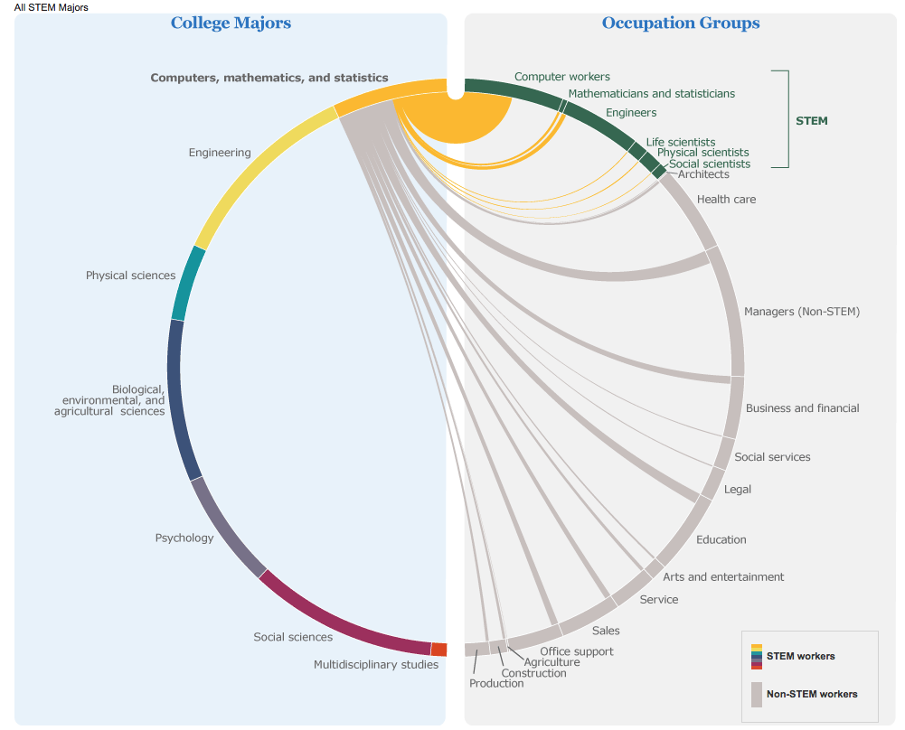
Example Pathways to STEM Workforce
https://www.census.gov/dataviz/visualizations/stem/stem-html/

Slide 5
Project Expectations
Conduct literature review on pathways to STEM occupations and how STEM needs are characterized both by the workers and employers
Develop pathways diagram(s) from Education to STEM workforce for 2-3 examples
Conduct data discovery process related to the pathways
Conduct data screening and inventory for discovered data
Use data in analysis to demonstrate STEM pathways for the 2-3 examples

